Slide 1


Git and Github
Git gud
Download Git!!
& Sign-Up on Github
(download oni)

Slide 2
Slides Content:
Version Control System
Installing & Configuring Git
Using GitBash (Windows) or terminal (Mac)
Initializing a Repo
Git Workflow
Viewing changes
Restoring previous versions
Git log
Collaboration
Create and share your repo
Cloning an existing repo
Remote repository, github!
Common additional files
Authentication
Adding a remote repository
Fetching and pulling
Pushing
Story so far
Branching
Merge conflicts, pull requests, forking
Contribute to open source by forking:
Git best practices!
Resources
Technical Issues
Add. slides/images

Slide 3
Learnin today:
What is Git?
Installing and configuring Git
Fundamentals of Git
Using VSCode with Git
Fundamentals of GitHub
A little on branching and collaborating

Slide 4

Version Control System
VCS: A system of recording changes to files.
Git is a VCS
Write a novel yay!

Slide 5

A system that:
Records changes made
Can recover previous versions
Allows us to work independently in a team
Stores files in one place
Introducing
Git: A distributed VCS that takes ‘snapshots’ of your project.
GitHub: A platform to collab on repositories (project).

Slide 6
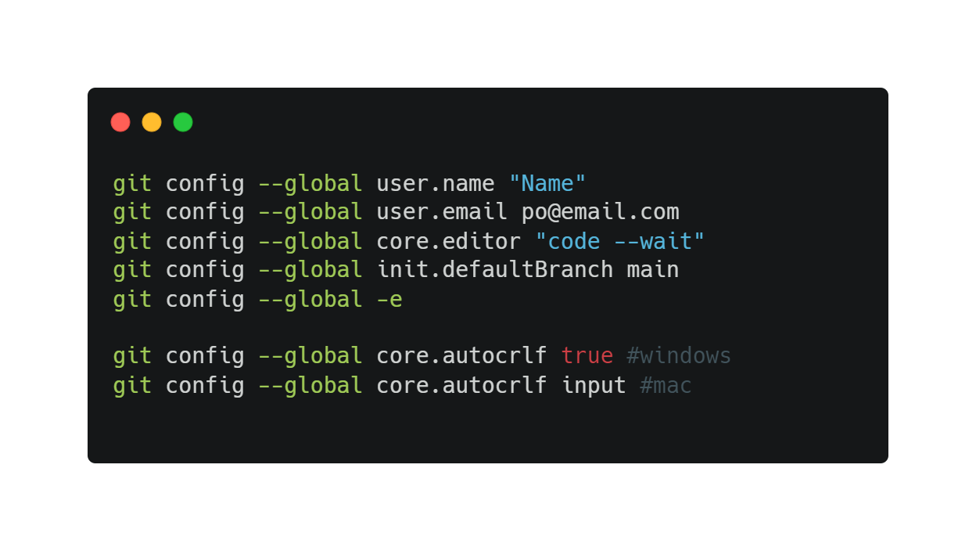
Installing & Configuring Git
Install Git for Windows or type git –-version in Mac terminal
Use GitBash (Windows) or terminal (Mac)
SYSTEM
All users
GLOBAL
All repos of current users
LOCAL
Current repo

Slide 7
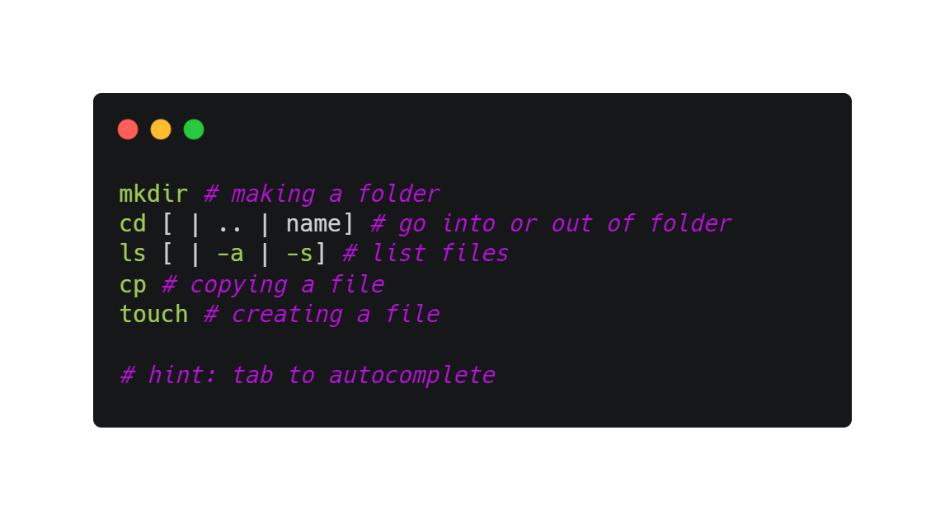
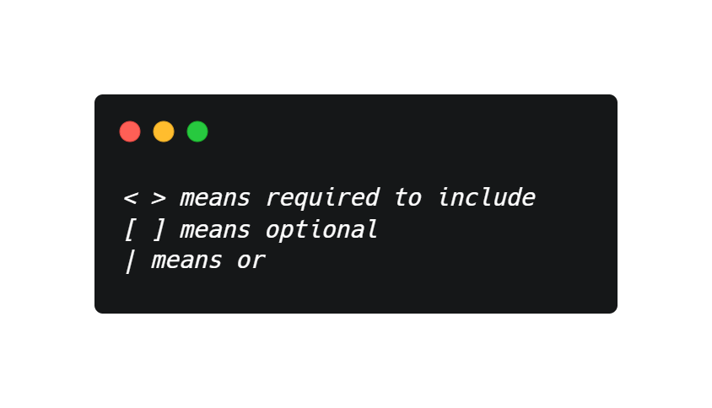
Git Bash
Terminal to interact with Git
Another command prompt

Slide 8
Basic git commands
git init -> git add -> git commit
git status
git log

Slide 9
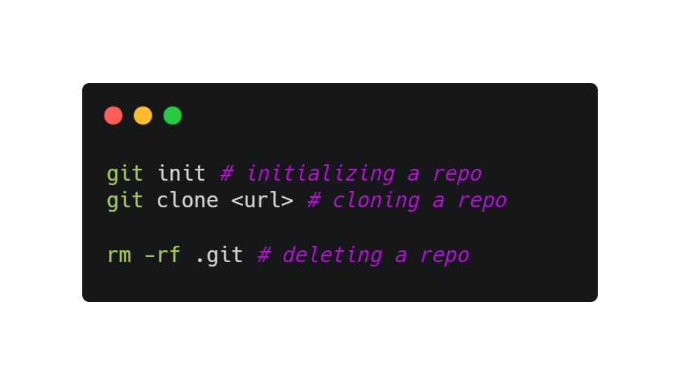
Initializing a Repo
A repository is a place to store all your project files.
Contains .git files (hidden)
Remote repository: hosted on a server
Local repository: resides on a computer of someone

Slide 10

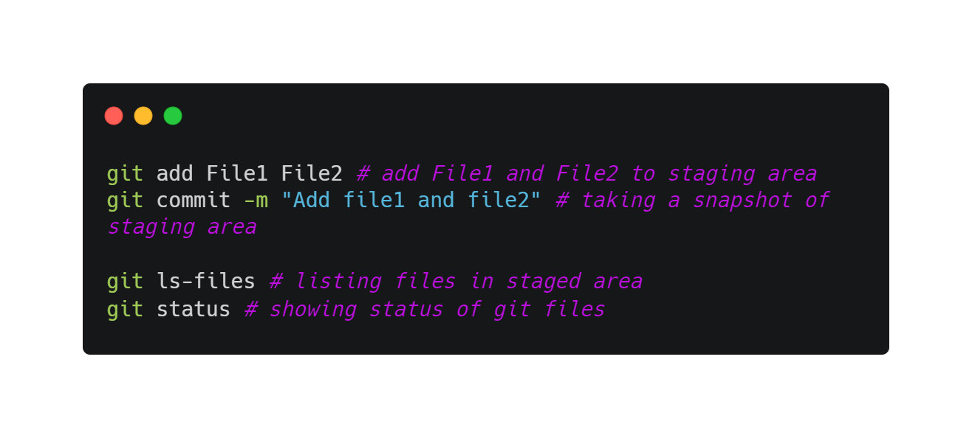
Flow
Staging area
Local repo
File 1
File 1
File 2
File 1
File 1
File 2
File 1
File 1
File 2
File 2

Slide 11
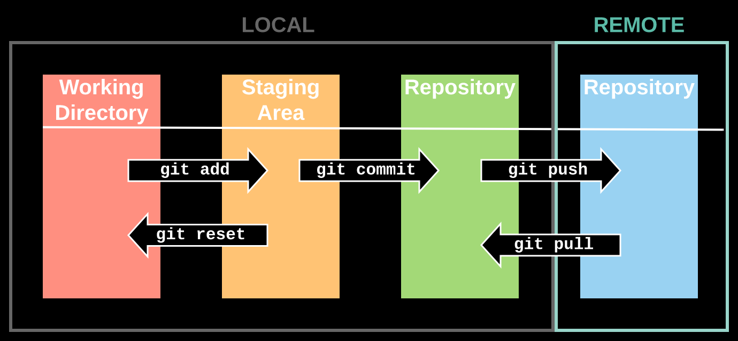
Git Workflow

Slide 12
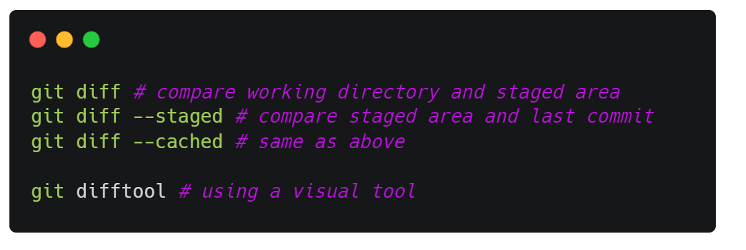
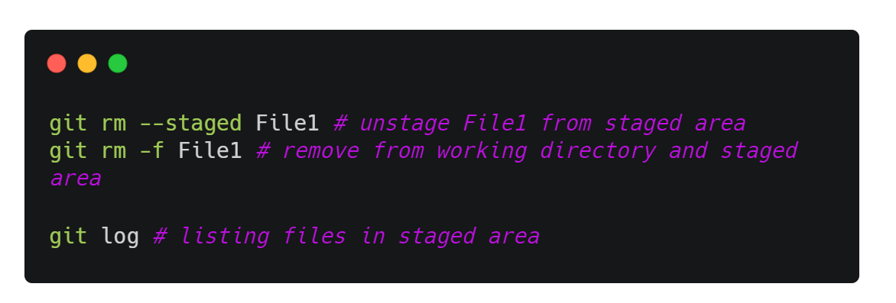
viewing changes
undoing changes
What happens if you remove the file from working directory?

Slide 13
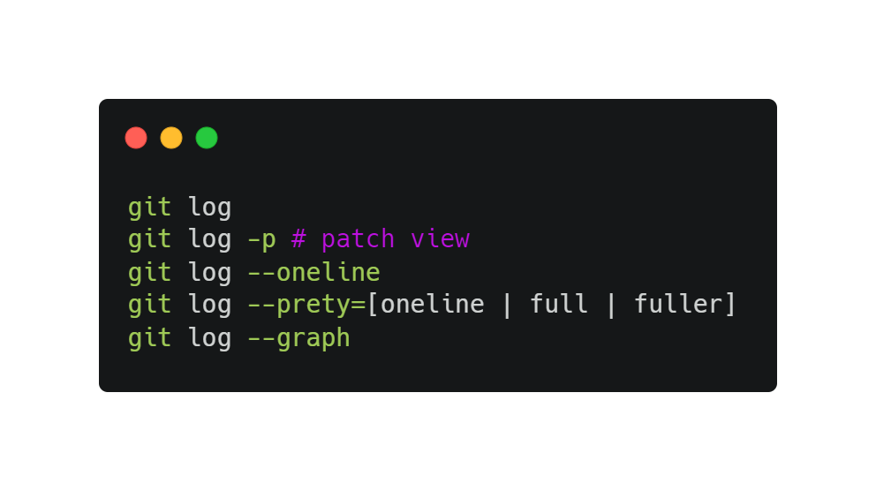
git log
Shows you details of a commit

Slide 14
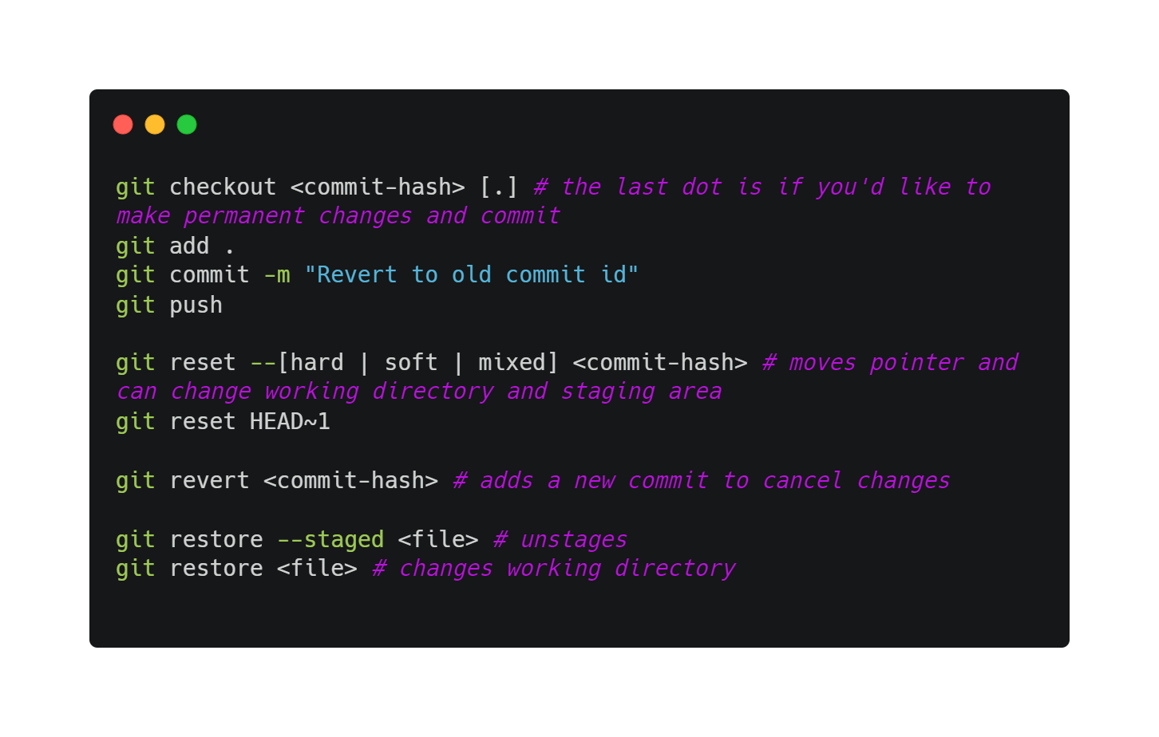
Restoring previous versions
Several methods to restore previous versions
git checkout
git reset
git revert
git restore

Slide 15
Recap:
GIT FLOW:
Create project.
git init -> git add -> git commit
Check status with git status
Check commits with git log
You can check differences, change to older version, undo changes
:D any q’s?

Slide 16

Collaboration
Now, you want to collaboratively write a book.
Register an account on Github!
Create title
Add paragraph 1
Add paragraph 2

Slide 17
Authentication
SSH: Older method
Personal access tokens: GitHub has updated their policies to have this.
Git Manager Credentials Core (comes installed) : So don’t need to worry so much
Authentication is to ensure security of your projects. If you have errors with permissions, this may be a reason why.

Slide 18
Collaboration
What do you wanna do?
I’m doing a group project!
OR
Open-source project

Slide 19
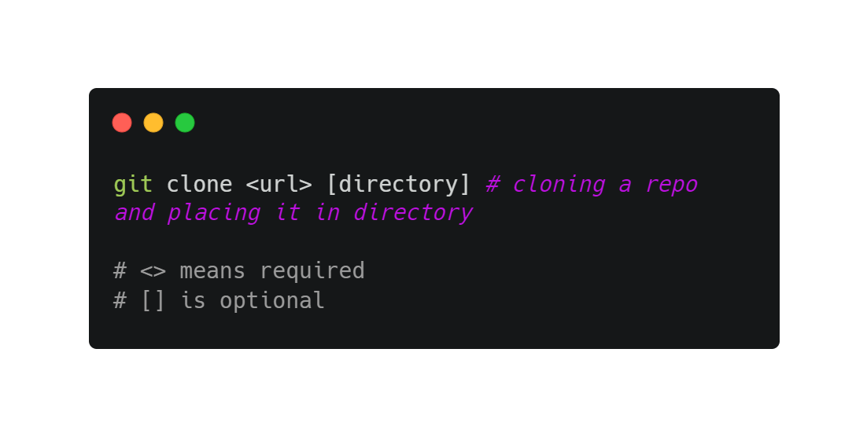
Cloning an existing repo
A full copy of nearly all data is retrieved
Includes all versions of the project
Why?

Slide 20
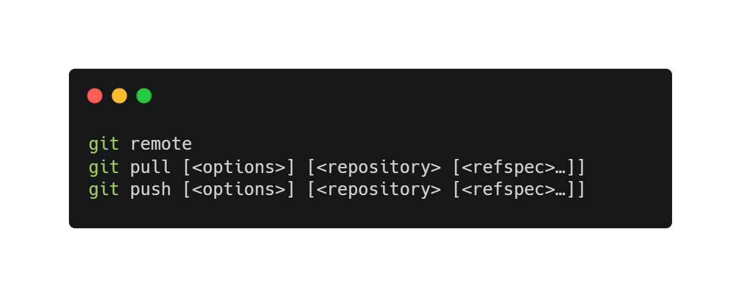
Remote repository, github!
Origin refers to the remote repository’s name by convention.

Slide 21
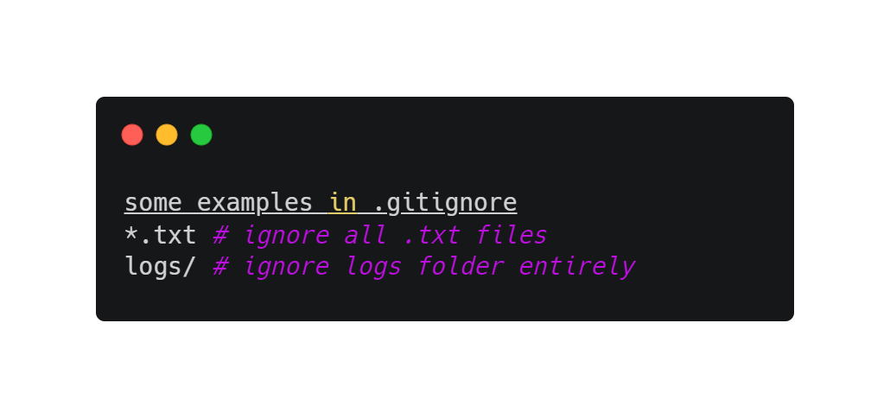
Common additional files
.gitignore is a way to ignore files in Git
README.md is to display text on GitHub

Slide 22
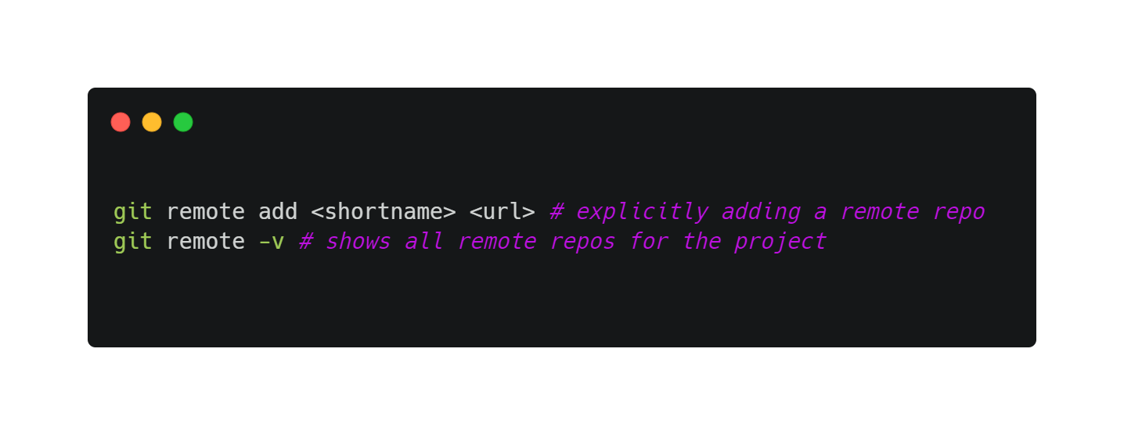
Adding a remote repository
git clone implicitly adds the remote repo for you under the name origin
To add one explicitly:

Slide 23
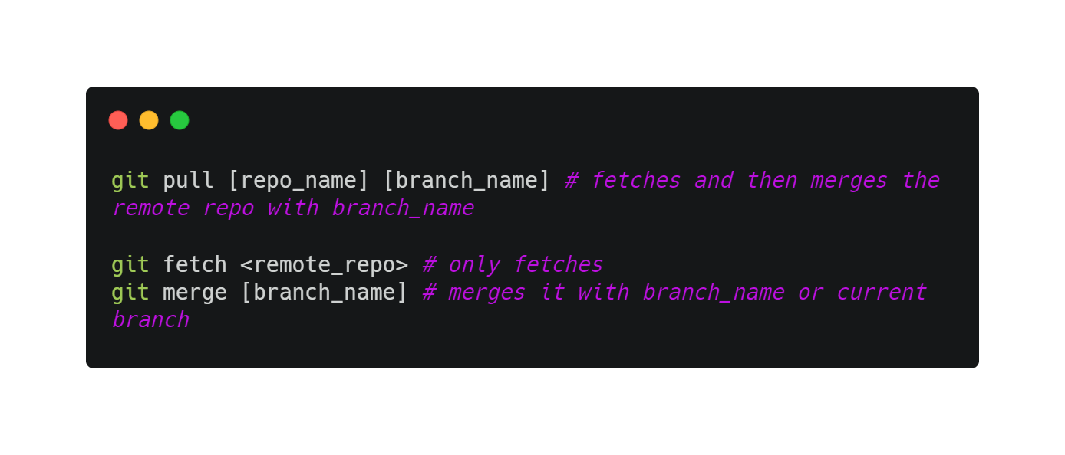
Fetching and pulling
git fetch command only downloads the data to your local repo but it does not merge or modify your work.
You have to do this manually.
git pull fetches the data and then merges that remote branch into your current branch. Additionally, git clone automatically sets up your local main branch to track the remote main branch.

Slide 24
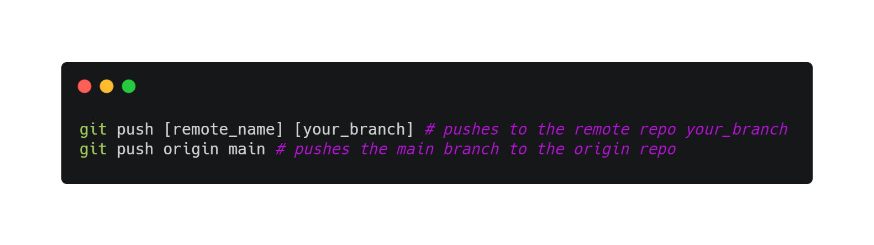
Pushing
Ready to share?
What happens when multiple people push at the same time? How about if you push before pulling?
You’ll get errors or conflicts! So always git pull before git push

Slide 25
Story so far

Slide 26
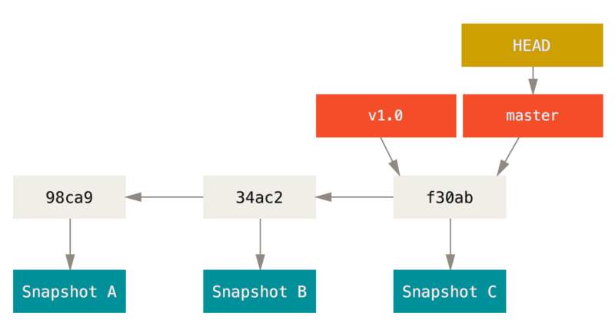
Branching
Diverge from the main development line and do your own stuff without messing the main line
Git stores snapshots, and a pointer that points to those snapshots

Slide 27
Branching
HEAD
Master
bc3ae
e39ae
s7bjk
d42ce
Switching branches changes your current working directory
chap2
chap2
HEAD
HEAD

Slide 28
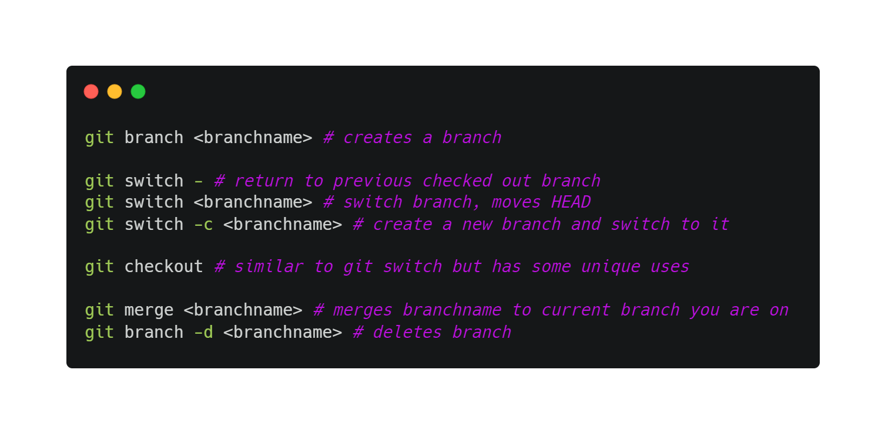
Branching
Switching branches changes your current working directory

Slide 29
Merge conflicts, pull requests, forking
Contributing to open source by forking:
i) Propose changes to someone’s project
ii) Use the code as your own project
iii) Does not affect original project
To work on open-source projects, look at the next slide!

Slide 30
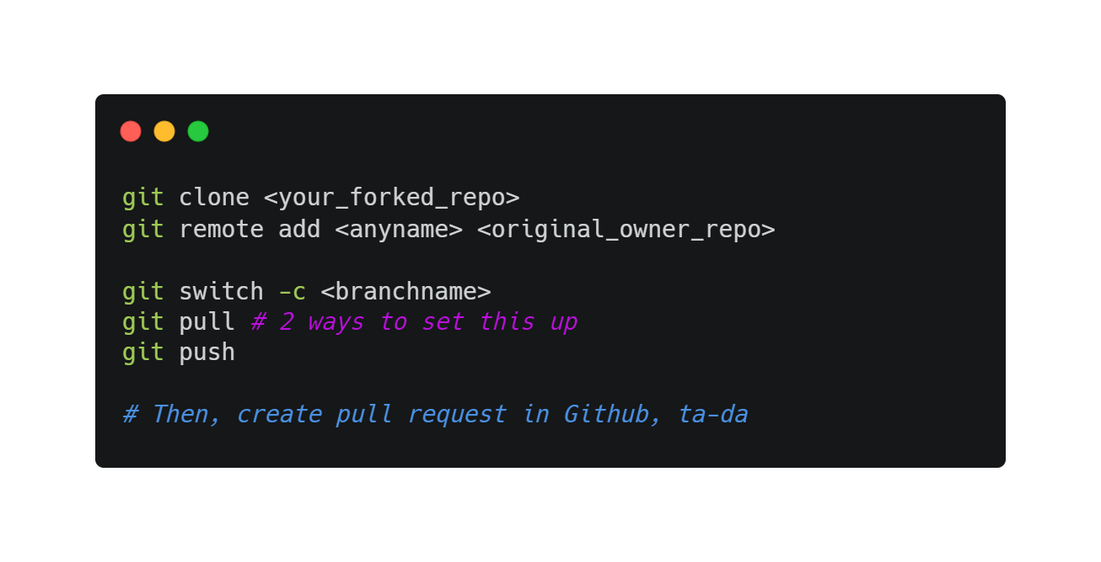
Contribute to open source by forking
https://www.atlassian.com/git/tutorials/comparing-workflows/forking-workflow#:~:text=Forking%20is%20a%20git%20clone,org%2FuserA%2Fopen%2Dproject

Slide 31
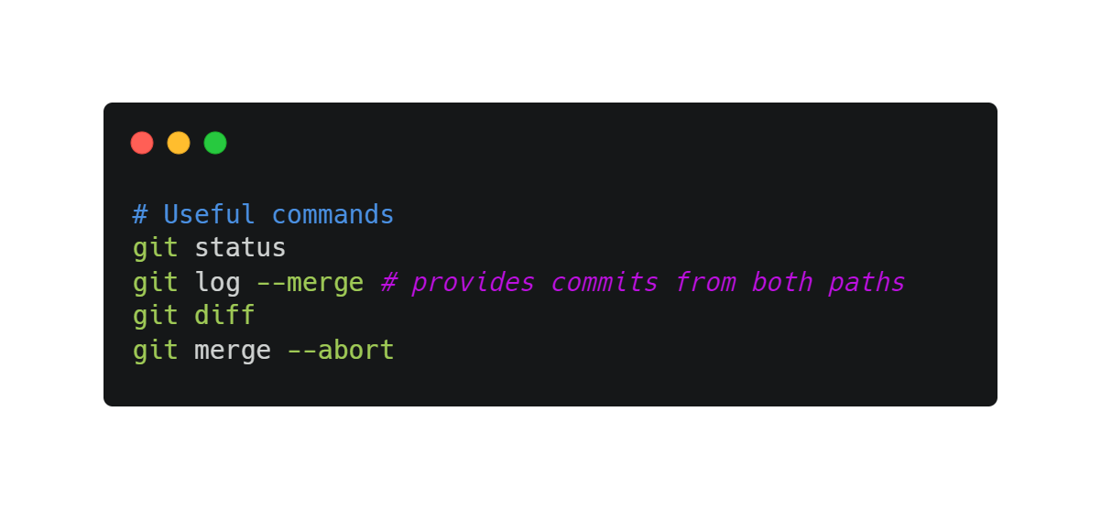
Merge conflicts
Once merge and conflict appears, open the file containing conflict
git add, then git commit

Slide 32

Git best practices!
Commit often!
Small but frequent commits
Commit related changes only (wrap related changes)
Commit completed changes
Meaningful commit messages

Slide 33
Resources
Pro Git Book
Bash commands
https://www.youtube.com/watch?v=8JJ101D3knE&ab_channel=ProgrammingwithMosh
Not covered today
Rebasing, reverting, more advanced git commands
In-depth on how Git works
Git visual tools like GitKraken

Slide 34
Challenge for you!
Check the exercises on git_tutorial repository
Do them and share on insta!! And tag me, Keng Son and STC.
We will be proud of you :)

Slide 35
Technical Issues
Configuring editor for Git (if you don’t use VSCode)

Slide 36
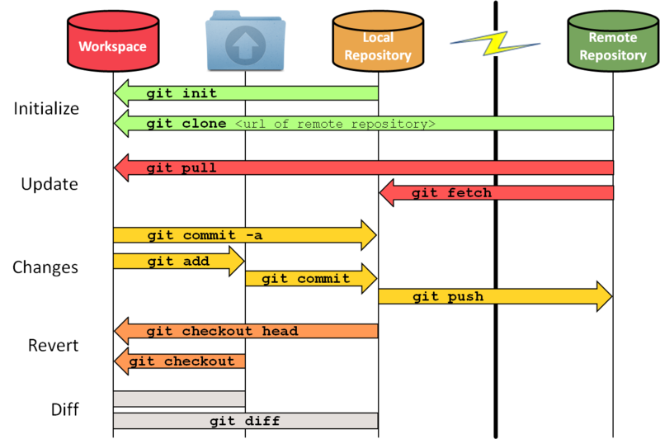
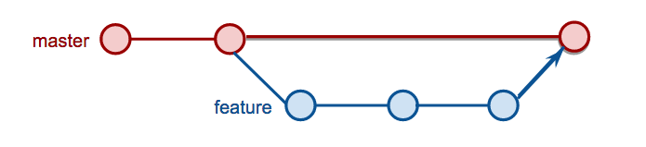
Add. slides/images
Untracked
unmodified
unmodified
Tracked
modified
staged
This Photo by Unknown Author is licensed under CC BY-SA
This Photo by Unknown Author is licensed under CC BY-NC

Slide 37
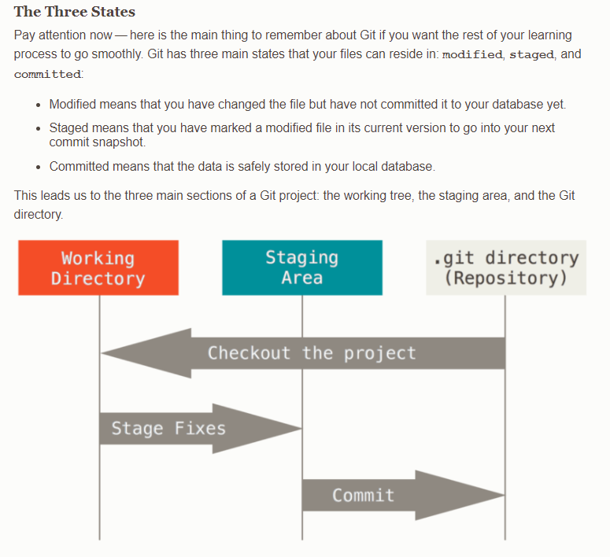
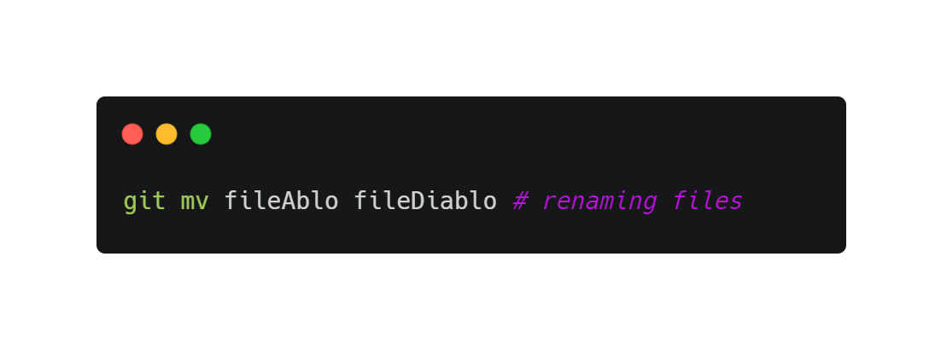
Add. slides/images

Slide 38
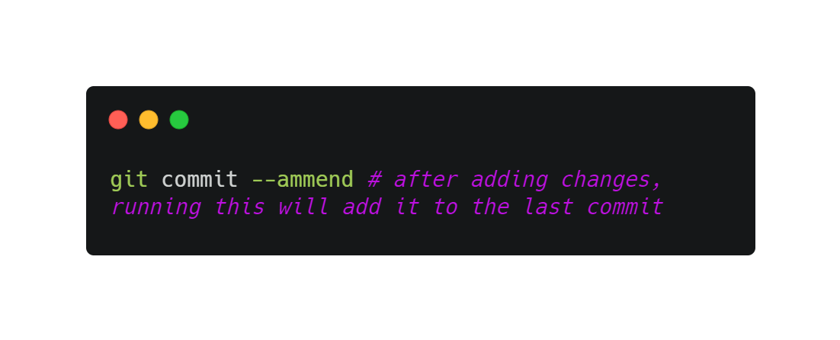
Add. slides/images

Slide 39
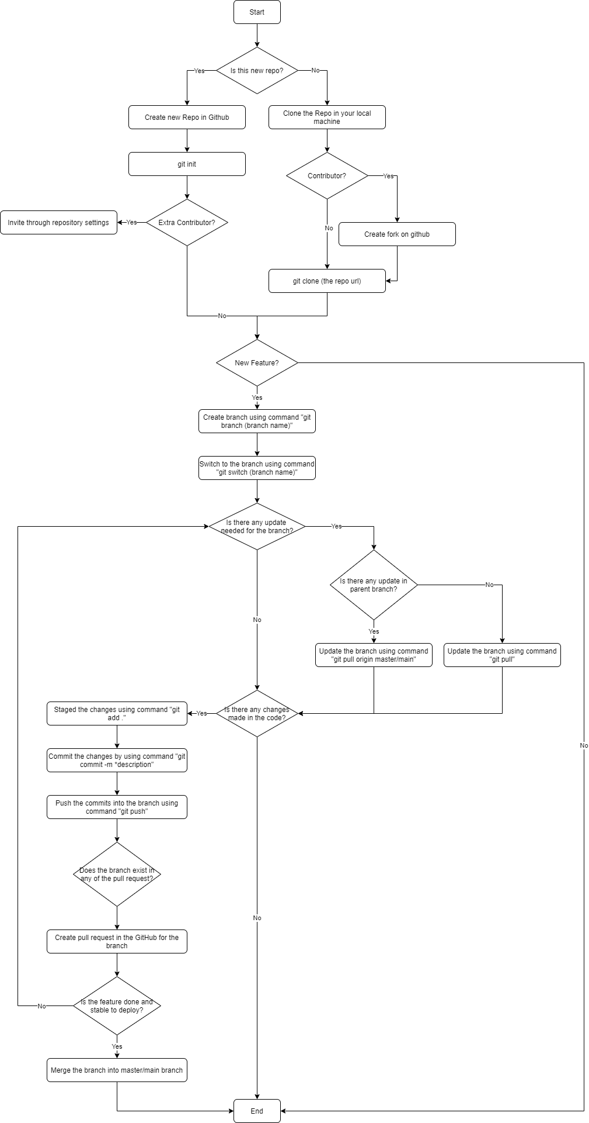
Add. slides/images

